Slide 1
Secure Systems Engineering Program Binaries
Chester Rebeiro
Indian Institute of Technology Madras

Slide 2
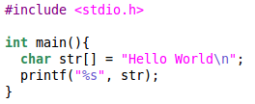
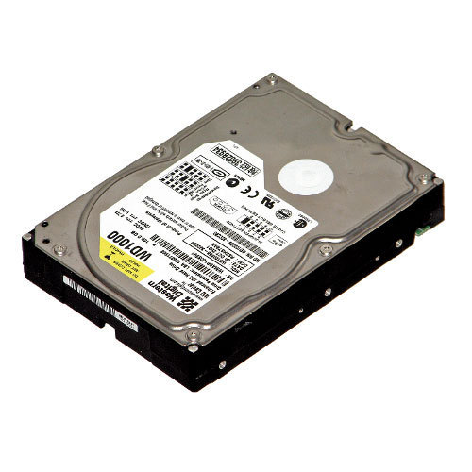
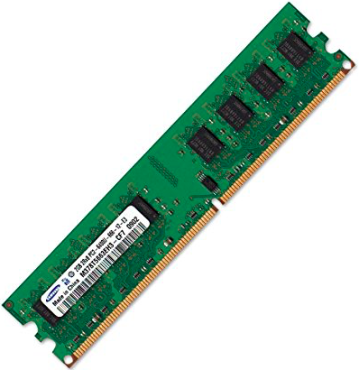
Executables and Processes
$gcc hello.c
Executable
ELF
(a.out)
Process
./a.out
Stored in disk
Executed from RAM

Slide 3
ELF Executables
$gcc hello.c
Executable
ELF
(a.out)
Process
./a.out
Executed from RAM
Stored in disk

Slide 4
ELF Executables (linker view)
$gcc hello.c -c
Describes the file organization
hello.o
ELF Header
Program header table
Section 1
This is an ELF
Object file
Section 2
Object file information such
as code, data, symbol table, relocation information, etc.
Section 3
Section 4
---
Section header table
Helps locate all the file’s sections
ref :www.skyfree.org/linux/references/ELF_Format.pdf
ref :man elf
Notes:
https://greek0.net/elf.html

Slide 5
ELF Header
Can have values relocatable object,
executable, shared object, core file
Identification
i386, X86_64, ARM, MIPS, etc.
type
virtual address where program
begins execution
Machine details
Entry
ELF Header
Program header table
Ptr to program header
Section 1
number of section headers
Section 2
Section 3
Section 4
Ptr to section header
---
number of section headers
Section header table

Slide 6
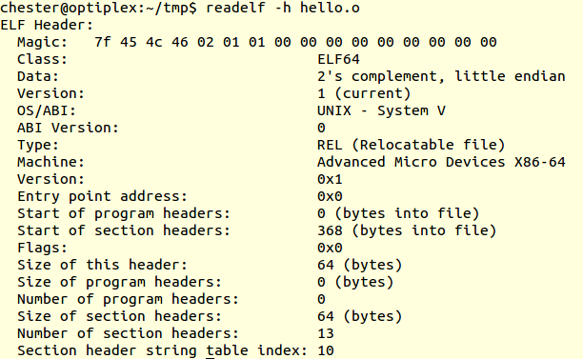
Hello World’s ELF Header
$ gcc hello.c –c
$ readelf –h hello.o

Slide 7
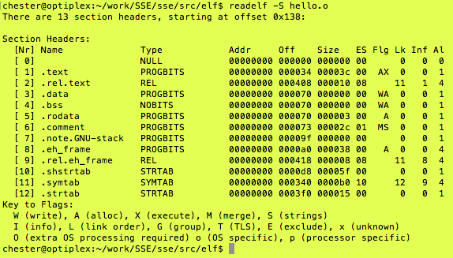
Section Headers
Contains
information about
the various sections
$ readelf -S hello.o
Virtual address where the
Section should be loaded
(* all 0s because this is a .o file)
Type of the section
PROGBITS : information defined by program
SYMTAB : symbol table
NULL : inactive section
NOBITS : Section that occupies no bits
RELA : Relocation table
Offset and size of the section
Notes:
Bss → contains uninitialized data

Slide 8
ELF Executables (Executable view)
$gcc hello.c -o hello
Describes the file organization
hello
ELF Header
Program header table
Helps locate all the file’s segments
Segment 1
This is an ELF
file
Segment 2
Object file information such
as instructions, data, symbol table, relocation information, etc.
Segment 3
Segment 4
---
Section header table
ELF Executable View
ref :www.skyfree.org/linux/references/ELF_Format.pdf
ref :man elf
Notes:
https://greek0.net/elf.html

Slide 9
Program Header (executable view)
Contains information about each segment
One program header for each segment
ELF Header
Program header table
Segment 1
Segment 2
Head 1
Segment 3
Head 2
Segment 4
Head 3
---
Head 4
---
---
Notes:
Offset of segment in ELF file ---- offset from the start of file

Slide 10
Program Header Contents
type
type of segment (loadable segment / shared lib /etc)
offset
Offset of segment in ELF file
vaddr offset
Virtual address where the segment is to be loaded
paddr offset
physical address where the segment is to be loaded.
(ignored)
Size in file image
Size in memory
flags
Read / write / executable

Slide 11
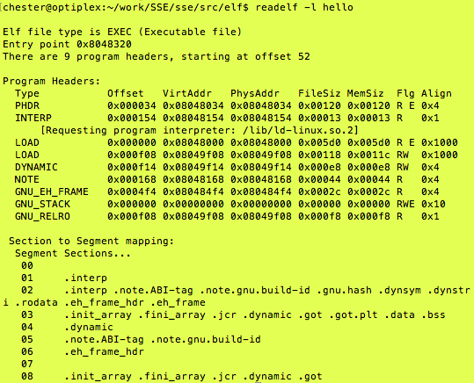
Program headers for Hello World
$ readelf –l hello
Mapping between
segments and sections
Notes:
Note: virtual addresses are not zero now
Phys address: not always applicable

Slide 12
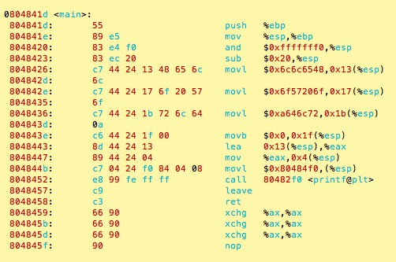
Contents of the Executable
$ objdump --disassemble-all hello > hello.lst

Slide 13
ELF Executables
$gcc hello.c
Executable
ELF
(a.out)
Process
./a.out
Executed from RAM
Stored in disk

Slide 14
Creating a Process by Cloning (using fork system call)
Parent
process
int p;
p = fork();
if (p > 0){
printf(“Parent : child PID = %d”, p);
p = wait();
printf(“Parent : child %d exited\n”, p);
} else{
printf(“In child process”);
execlp(“hello”, “”, NULL);
exit(0);
}
child process
p=child’s PID
p=0

Slide 15
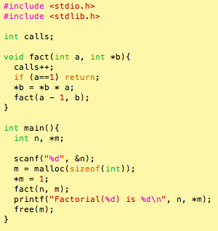
Process Virtual Memory Map
Stack
MAX_SIZE
Heap
Data
Text
(instructions)
0
Program
Virtual Memory Map

Slide 16
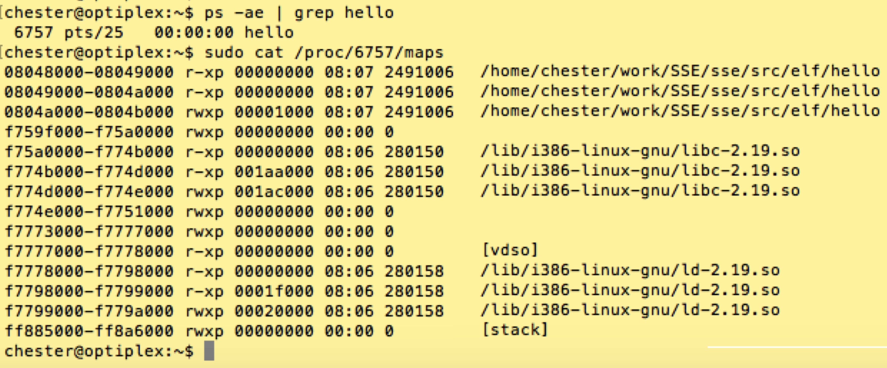
Process Virtual Memory Map
Virtual address
memory range
flags
Device details (offset in file; device number; inode)

Slide 17
Stack Frames
Stack
%ebp
main locals
main frame
%esp
PC
Program
%esp : stack pointer
%ebp : frame pointer

Slide 18
Stack Frames
Stack
%ebp
main locals
Parameters to fact
%esp
Return address
PC
Program
%esp : stack pointer
%ebp : frame pointer

Slide 19
Stack Frames
Stack
main locals
PC
Parameters to fact
Return address
%ebp
prev ebp
fact locals
Fact frame
(Ist invocation)
%esp
Program
%esp : stack pointer
%ebp : frame pointer

Slide 20
Stack Frames
Stack
main locals
PC
Parameters to fact
Return address
prev ebp
fact locals
Parameters to fact
Return address
%ebp
Prev ebp
Program
fact locals
Fact frame
(IInd invocation)
%esp : stack pointer
%ebp : frame pointer
%esp

Slide 21
Stack Frames
Stack
main locals
Parameters to fact
Return address
PC
%ebp
Prev ebp
fact locals
Fact frame
(Ist invocation)
%esp
Program
%esp : stack pointer
%ebp : frame pointer

Slide 22
Stack frames
Stack
%ebp
main locals
main frame
%esp
PC
Program
%esp : stack pointer
%ebp : frame pointer

Slide 23

Points to Ponder
How and who passes command line arguments to the process?

